Slide 1
Climate Change
By: Claudia Arias

Slide 2
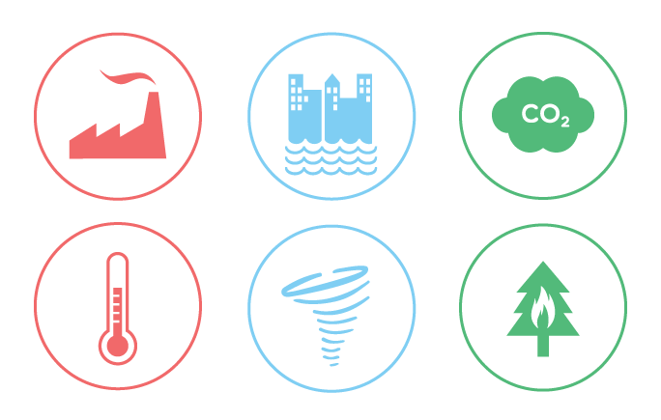
What is this project about?
This project discusses Climate change & Global warming as it relates to our current events in a way that is engaging, interactive and entertaining.
I am hoping that it not only teaches facts about the subject but that it is a reflection of what I have learned in class and on my own studies.

Slide 3
Background
My inspiration for this project was reading about climate change while browsing the NASA site. It seems like a hot topic recently because of the new administration and the worldwide reaction to the issue.
https://climate.nasa.gov/
My audience is anyone that wishes to learn facts about climate change, whether for or against, and wants to watch an engaging and creative way to explain the topic.
This project is important because it is a way to discuss a hot and serious topic with multimedia, which makes it easier to follow and less monotonous and unimaginative.

Slide 4
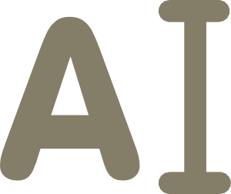
Precedent
The videos below use all elements of multimedia—text, graphics, video, animation and audio—to share a message with their viewers. It makes them engaging and informative at the same time. It is also a very trendy way news sites have opted to use to share their news for a while now, especially to a younger audience.
https://www.youtube.com/watch?v=DkZ7BJQupVA
https://www.youtube.com/watch?v=S7jpMG5DS4Q
https://www.youtube.com/watch?v=2SNydPRZzzA

Slide 5
Animation
I wanted to do an animated piece since drawing and animating is my passion. I wanted to try a new way of animating that includes various forms projecting the main idea.
Graphics and text have been the way most news, especially the ones aimed at a younger audience, have shared their coverage.
Video & Audio interviews allow the audience to get an insight to specialists’ perspectives and different points of views on the subject.
I made my project with these thoughts as my main focus.

Slide 6
Materials
Social Media
To get an idea on what people are saying about the topic.
NASA website as well as other websites to gather the information.
https://climate.nasa.gov/
https://www.nytimes.com/topic/subject/global-warming-climate-change
http://www.nature.com/nclimate/journal/v6/n8/full/nclimate3004.html
http://data.worldbank.org/topic/climate-change
http://www.un.org/sustainabledevelopment/climate-change-2/
https://www.usda.gov/oce/climate_change/
Pen and Paper
Used for storyboarding and brainstorming.
Drawing and Animation software app.
Clip Studio Paint
Wacom Drawing Tablet
[INSERT IMAGES]

Slide 7
Project
[insert link]

Slide 8
Conclusion
The project conveyed my idea in a way that is better than expected.
I could see it being shown in class but its primary audience is social media users.
If I could change something about it, I would spend more time on it. I do not believe the product is ‘unsatisfying’ or ‘unfinished’, but since it is an animation, it usually takes longer to complete it.
I plan to leave this project up on Youtube, to see how much traffic it gathers, audience demographic and their opinions on it.

