Slide 1
Climate Change
By Claudia Arias

Slide 2
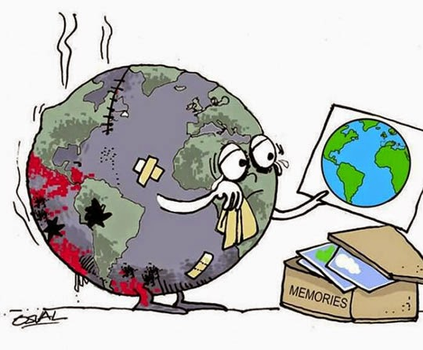
What is this project about?
My project is about Climate change & Global warming as it relates to our current events. With this project, I seek to incorporate the 5 elements of multimedia to make the experience more engaging and entertaining.
The Project will be artistic, informative and creative, and I am hoping that it is a reflection of what I have learned in class and on my own studies.

Slide 3
These videos use all elements of multimedia—text, graphics, video, animation and audio—to share the message with their viewers. It makes them engaging and informative at the same time. It is also a very trendy way news sites have opted to use to share their news for a while now, especially to a younger audience.
https://www.youtube.com/watch?v=DkZ7BJQupVA
https://www.youtube.com/watch?v=S7jpMG5DS4Q
https://www.youtube.com/watch?v=2SNydPRZzzA
Demo

